Slide 1
XML Documents

Slide 2
Topics
To identify the different components of an XML document
About XML parsers, applications, and errors
How to recognize the basic logical structure of an XML document
About XML’s basic well formedness and validity requirements
How to build and modify XML documents

Slide 3
Defining an XML Document
XML Processor or Parser
Software
Reads the document
Provides front-end validation of the document on behalf of the application
Provides access to document content and structure
Application
Intended for the end users and designers to access and manipulate XML documents

Slide 4
Defining an XML Document
Fatal Error
Error in the document that must be detected and reported to the application.
When it occurs, XML parser does not continue normal processing

Slide 5
Document Components
Physical Structure
Entities
Fragments of XML document
Range in type and scope from single characters to entire outside documents identified by their respective entity reference names
Types of Entities
Parsed entities contain text
Unparsed entities may contain text and may contain formats other than XML
Notes:
PCDATA and CDATA

Slide 6
Document Components
Logical Structure
Each document contains one or more elements
Containers of document information that can be nested within other elements
Boundaries of each element delimited by tags
Each element may described as a type or generic identifier (GI)‏

Slide 7
Defining an XML Document
XML documents are a class of data objects
XML documents consist of three parts
The prolog
The document body
The epilog
Notes:
Prolog is actually optional

Slide 8
Document Components - Prolog
Facilitates passing of data and other information to the parser and afterward to the application
First major component of an XML document
Must be inserted in the root element or document
May contain 5 possible elements:
XML declaration, Processing instructions, Document Type Definition, Comments, and White space

Slide 9
Document Components - Prolog
The first section contains global information such as the XML version, formatting information, and schema definitions
The question mark indicates that this tag, XML, is a processing instruction and therefore does not contain data. The Character-encoding property describes any coding algorithms
<?xml version="1.0" encoding="utf-8" ?>
Add a reference to a CSS stylesheet in an XML document to an external Cascading Style Sheet (CSS) or an XSL file to format the XML document
<?xml-stylesheet type="text/css" href="taragifts.css"?>

Slide 10
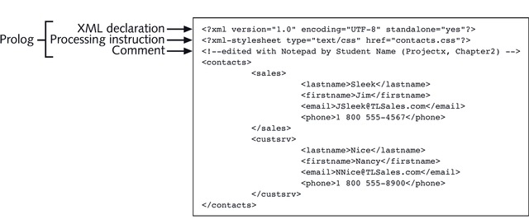
XML Declaration

Slide 11
XML Declaration
The previous example contains 3 attributes.
XML version - mandatory to state the current version in the XML declaration statement
Encoding Attribute (optional)‏
Choices available are UTF-8 (default), Unicode, UCS-2, UCS-4 and several other character sets
Standalone Attribute (optional)‏
There are no external physical entities such as DTDs or schemas in the XML document

Slide 12
Comments
Used to provide information to the XML document
Or to temporarily disable sections or markup and content
Text contained between the tags <!-- and -- > is invisible to application processing the document
Just like HTML

Slide 13
The Body
The XML document complies with the XML DOM standards
The XML DOM states that XML documents must have a logical structure
The root container element (node) must nest all the elements and data
The root node can contain many other elements
All tags must be nested within the root node (or root tag)‏
The root node is a container element because all elements must be nested within the root element in an XML document

Slide 14
Sample Root Node
Productlist is the root node and contains other nodes
<productlist>
<product>
<code>387-463-55-00</code>
<name>Waterford Crystal Shamrock Paperweight</name>
<price>99.00</price>
<category>Waterford</category>
<image>547.gif</image>
<rating>4</rating>
</product>
…
</productlist>

Slide 15
The Element Hierarchy
Elements are the building blocks of XML
Elements contain an opening tag and a closing tag
Content is stored between the tags
Displaying XML documents
Simple text editors - most typical
Tree diagram - typical for more complicated diagrams

Slide 16
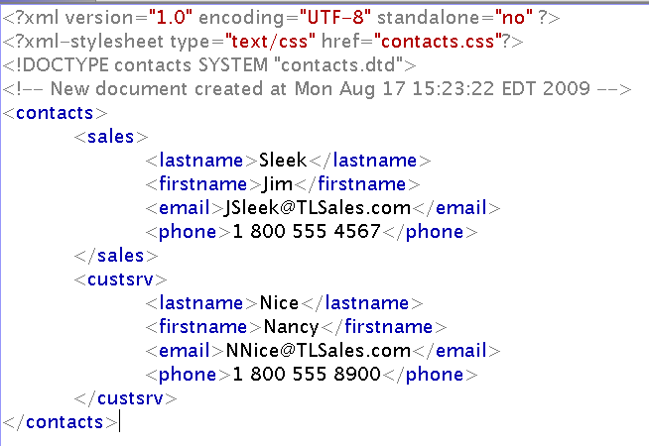
contacts.xml
contacts
sales
custsrv
lastname
firstname
email
phone
lastname
firstname
email
phone

Slide 17
XML Document Structure
Root element is the parent element of all elements
All elements within the document are contained with in the root element
Nesting - placing one element with another
Non parent elements - child elements or sub-elements
Child elements - sibling elements are at the same level and share one parent element
Notes:
Elements can be nested

Slide 18
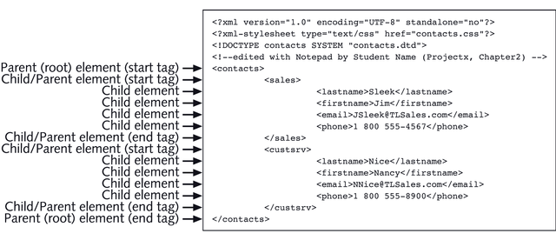
Element Hierarchy Example

Slide 19
Element Components and Properties
Tag and Tag Names
Opening Tag and Ending Tags are required
Tags are delimited by angle brackets
< indicates the beginning of a tag
> indicates the end
In the end tag, the element is always preceded by the slash (/)‏

Slide 20
Element Hierarchy
Rules for element tag names
Tag names begin with a letter or underscore (no numbers)‏
Tag names can not contain reserved XML symbols
The ampersand (&), the "at" symbol (@), or the less than symbol (<)‏
Tag names cannot contain white space

Slide 21
Attributes
Elements may or may not include attribute specifications
An attribute is a feature or characteristic of an element.
Attributes are text strings and must be placed in single or double quotes. The syntax is:
<element_name attribute=“value”> … </element_name>

Slide 22
Using Attributes
Attributes are inserted into the start tag, immediately after the element name.
XML parser reads the attribute specification and passes the data to the application
Parser may impose limits on length of attribute
Attribute names follow the same element tags name rules
All attribute values must be in quotes
Notes:
Remember XML is case sensitive
Why would you use an attribute instead of a subelement?

Slide 23
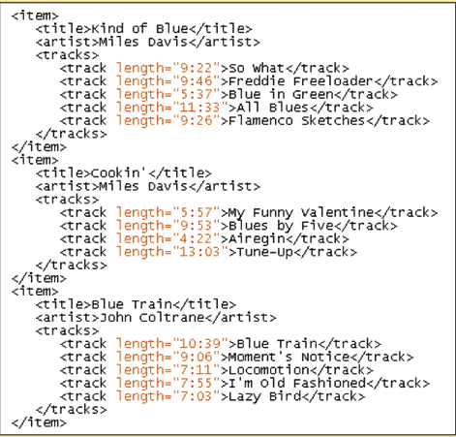
Attribute Example
{
Elements with attributes

Slide 24
Element Hierarchy
XML and White Space
Used to organize a document or for better legibility.
White space - spaces, tabs, carriage returns, and blank lines.
Entities
Physical storage units that can hold parseable strings or blocks of text that are not parseable (non XML data-like graphics).

Slide 25
Element Hierarchy
XML Reserved characters
Left angle bracket, or “less than” symbol (<)‏
Right angle bracket, or “greater than” symbol (>)‏
Double quotation mark(“)‏
Apostrophe, or single quotation mark(‘)‏
Ampersand (&)‏
Notes:
Provides five predefined general entities, one for each reserved word.
lt, gt, quot, apos, and amp

Slide 26
Types of Entities
Used in the content of the XML document
Defined in DTD
General Entities
<!ENTITY entity ”value”> - internal
<!ENTITY entity SYSTEM “uri”> - external
<!ENTITY entity PUBLIC “id” “uri”> - external
Parameter Entities
<!ENTITY % entity ”value”> - internal
<!ENTITY % entity SYSTEM “uri”> - external
<!ENTITY % entity PUBLIC “id” “uri”> - external

Slide 27
Entity Categories
Internal
Defined completely within the XML document that references them
External
Content is found in an external source (e.g., a file);
Reference usually includes the URI that points to their location

Slide 28
Entity Categories
Parsed
Content is well-formed XML text
Unparsed
Content is simple text, binary data or any other data the XML parser does not interpret

Slide 29
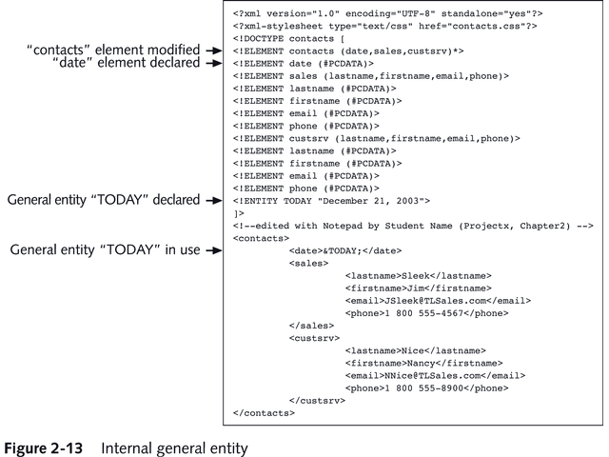
Example DTD

Slide 30
Element Hierarchy
CDATA Sections - Large block of text the XML processor interprets only as text
Retain information about white space and useful for creating and maintaining areas of program code
Can not be nested.
One set of ]]> indicators, the CDATA section is ended.
Additional markup instructions between the <![CDATA and ]]> are not recognized by the parser and these characters are passed directly to the application.

Slide 31
Well-formed and Valid XML Documents
An XML document is well-formed if it contains no syntax errors and fulfills all of the specifications for XML code as defined by the W3C.
An XML document is valid if it is well-formed and also satisfies the rules laid out in the DTD or schema attached to the document.

Slide 32
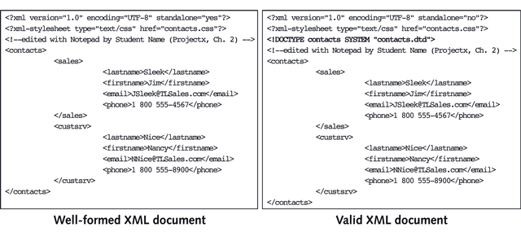
Well-formed Versus Valid

Slide 33
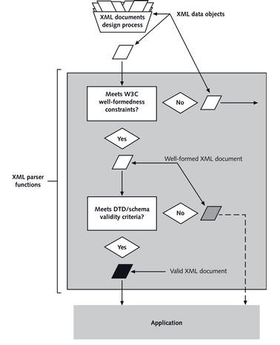
XML Document Processing
Notes:
XML Data Object
Checked by XML parser and met the W3C’s well-formedness constraints
XML parser checks XML document for validity
If valid, the document is made available for processing by the application

Slide 34
XML Editing Tools
View the XML document using an XML parser
MSXML Parser is built into Internet Explorer
XML documents can be used by other types of applications such as Window Forms
Create the XML documents using:
Simple text editor such as Notepad or Notepad++
Visual Studio .NET provides HTML/XML editor
Microsoft XML NotePad called xmlpad.exe
Dreamweaver provides XML template
File extensions
Generally saved with the file extension .xml

Slide 35
Linking to a Style Sheet
Link the XML document to a style sheet to format the document.
The XML processor will combine the style sheet with the XML document to display a formatted document.
There are two main style sheet languages used with XML:
Cascading Style Sheets (CSS) and Extensible Style Sheets (XSL)

Slide 36
Applying a Style to an Element
To apply a style sheet to a document, use the following syntax:
selector {attribute1:value1; attribute2:value2; …}
selector is an element (or set of elements) from the XML document
attribute and value are the style attributes and attribute values to be applied to the document

Slide 37
Applying a Style to an Element
For example:
artist {color:red; font-weight:bold;}
Will display the text of the artist element in a red boldface type

Slide 38
Creating Processing Instructions
The link from the XML document to a style sheet is created using a processing statement.
A processing instruction is a command that gives instructions to the XML parser.

Slide 39
Creating Processing Instructions
For example:
<?xml-stylesheet type=“style” href=“sheet” ?>
Style is the type of style sheet to access and sheet is the name and location of the style sheet.
Notes:
Show jazz example

